Slide 1


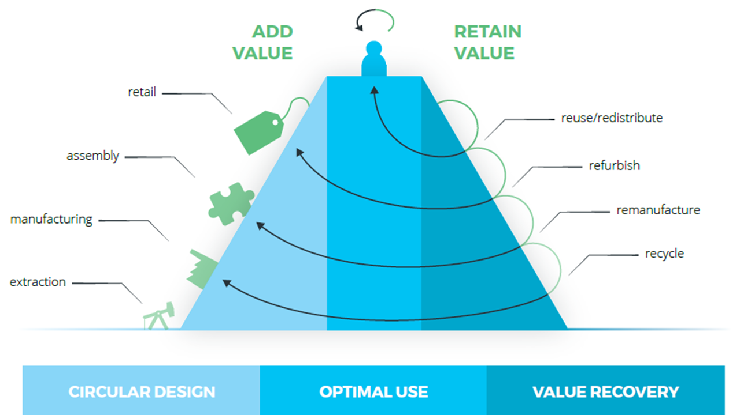
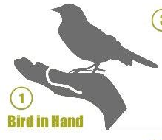
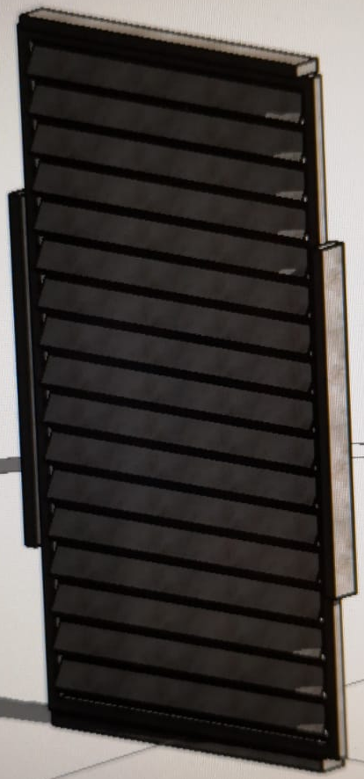



Idea development
Idea description:
Can this idea be realized locally? How?
Parts and/or materials used:
Where is this idea located on the value pyramid? Reuse
New function of the idea:
Are the things, needed to accomplish this, within your reach?
Draw idea:
Some of the images used on this workshop come from Circle-e
This work is licensed under the Creative Commons Attribution-Share Alike 3.0 Unported License

